Slide 1
10 June 2020

Slide 2

APPLIED CRYPTOGRAPHY
Lecture 1

Slide 3
Polynomials
10 June 2020

Slide 4
Introduction
A polynomial of degree n − 1 is an expression of the form
where x^{i} is called the ith term and a_{i} is called coefficient of the ith term.
10 June 2020

Slide 5
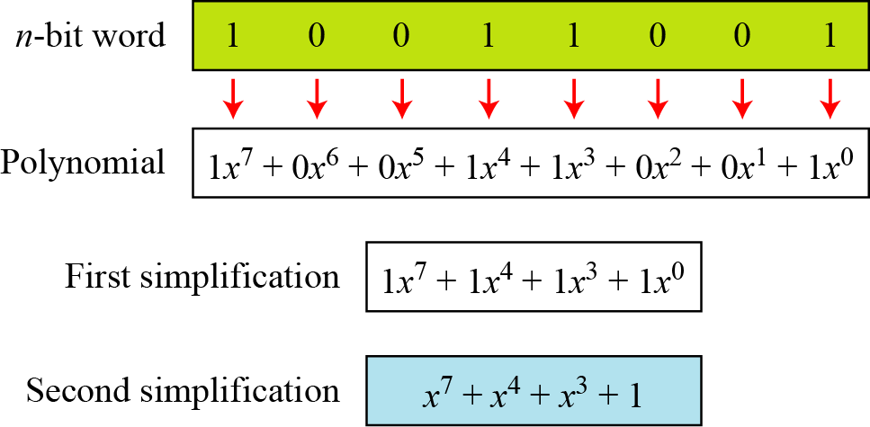
Introduction
Figure show how we can represent the 8-bit word (10011001) using a polynomials.
Representation of an 8-bit word by a polynomial
10 June 2020

Slide 6
Example
To find the 8-bit word related to the polynomial x⁵ + x² + x,
we first supply the omitted terms. Since n = 8, it means the
polynomial is of degree 7. The expanded polynomial is
This is related to the 8-bit word 00100110.
10 June 2020

Slide 7
GF(2^{n}) Fields
Polynomials representing n-bit words use two fields:
GF(2) and GF(2^{n}).
10 June 2020

Slide 8
Example-1
For the sets of polynomials in GF(2^{n}), a group of polynomials of degree n is defined as the modulus. Such polynomials are referred to as irreducible polynomials.
List of irreducible polynomials
10 June 2020

Slide 9
Addition and Subtraction operation
Addition and subtraction operations on polynomials are the
same operation.
Let us do (x⁵ + x² + x) ⊕ (x³ + x² + 1) in GF(2⁸). We use the symbol to
show ⊕ that we mean polynomial addition. The following shows the
procedure:
10 June 2020

Slide 10
Example
There is also another short cut. Because the addition in GF(2)
means the exclusive-or (XOR) operation. So we can exclusive-or the
two words, bits by bits, to get the result.
In the previous example, x⁵ + x² + x is 00100110 and x³ + x² + 1 is
00001101. The result is 00101011 or in polynomial notation
x⁵ + x³ + x + 1.
8 July 2020

Slide 11
Example
1. The coefficient multiplication is done in GF(2).
2. The multiplying x^{i} by x^{j} results in x^{i+j}.
3. The multiplication may create terms with degree more than n − 1, which means the result needs to be reduced using a modulus polynomial.

Slide 12
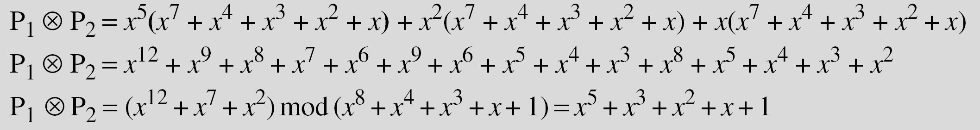
Example for Multiplication
Find the result of (x⁵ + x² + x) ⊗ (x⁷ + x⁴ + x³ + x² + x) in GF(2⁸) with irreducible
polynomial (x⁸ + x⁴ + x³ + x + 1). Note that we use the symbol ⊗ to show the
multiplication of two polynomials.
To find the final result, divide the polynomial of degree 12 by the polynomial of degree 8 (the modulus) and keep only the remainder.

Slide 13
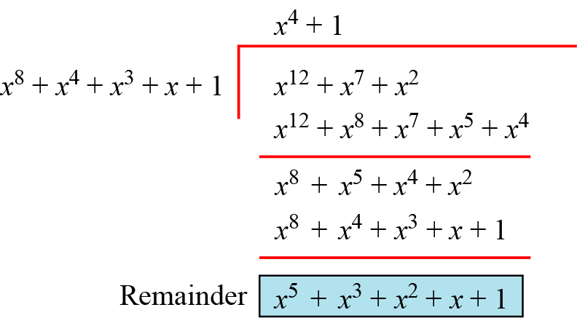
Example for Division

Slide 14
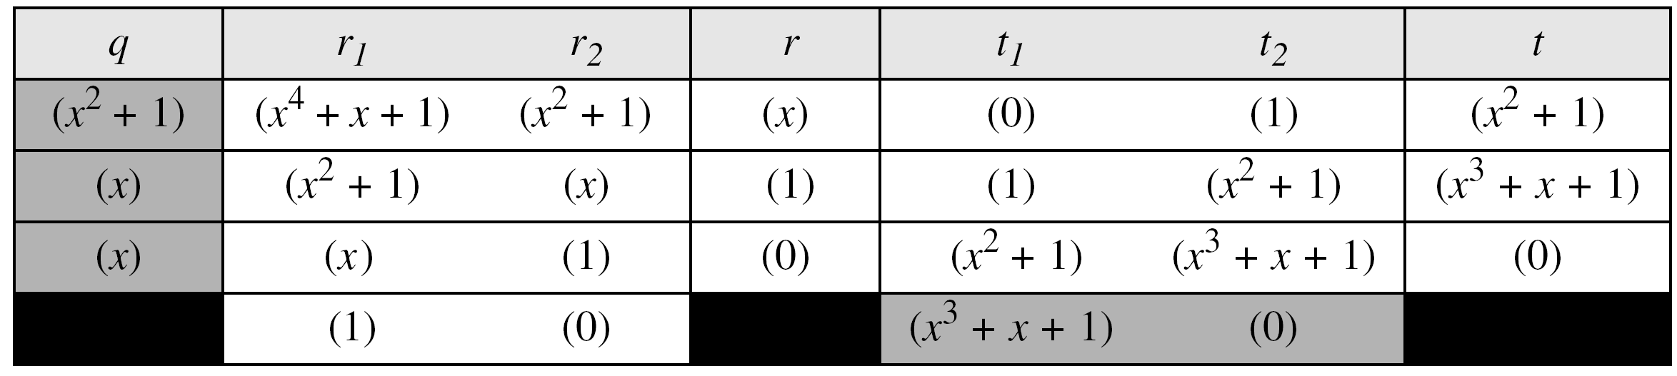
Continued.. Example
In GF (2⁴), find the inverse of (x² + 1) modulo (x⁴ + x + 1).
Solution: The answer is (x³ + x + 1) as shown in Table
Euclidean algorithm

Slide 15
Continued .. Example
In GF(2⁸), find the inverse of (x⁵) modulo (x⁸ + x⁴ + x³ + x + 1).
Solution: The answer is (x⁵ + x⁴ + x³ + x) as shown in Table
Euclidean algorithm

Slide 16
Multiplication Using Computer
The computer implementation uses a better algorithm, repeatedly multiplying a
reduced polynomial by x.

Slide 17
Example
Find the result of multiplying P₁ = (x⁵ + x² + x) by P₂ = (x⁷ + x⁴ + x³ + x² + x) in
GF(2⁸) with irreducible polynomial (x⁸ + x⁴ + x³ + x + 1) using the algorithm
described above.
Solution:
The process is shown in Table. We first find the partial result of
multiplying x⁰, x¹, x², x³, x⁴, and x⁵ by P₂.
Note that although only three terms are needed, the product of
x^{m} ⊗ P₂ for m from 0 to 5 because each calculation depends on
the previous result.

Slide 18
Continued ..
An efficient algorithm

Slide 19
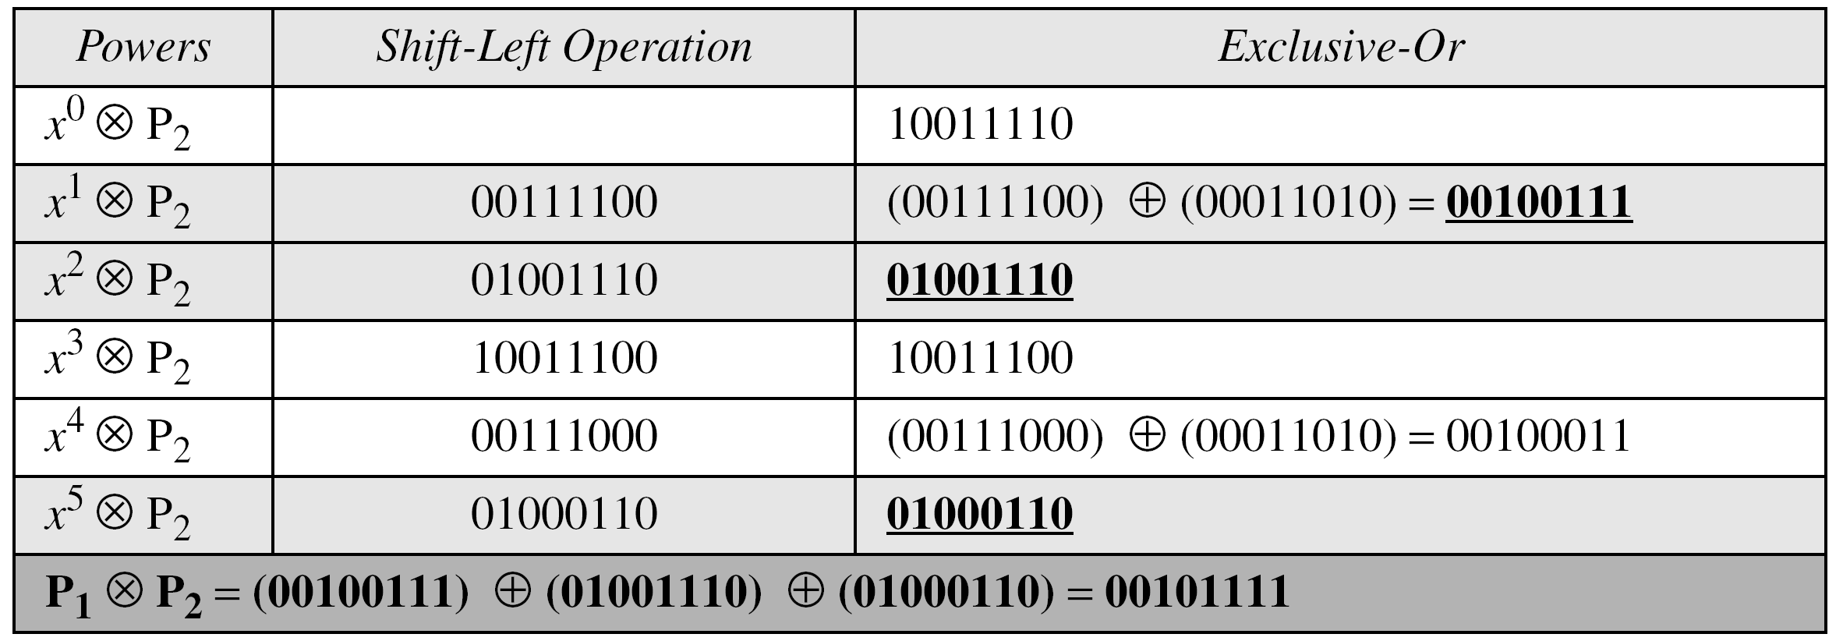
Example
Repeat Example 4.22 using bit patterns of size 8.
Solution: We have P1 = 000100110, P2 = 10011110, modulus = 100011010 (nine
bits). We show the exclusive or operation by ⊕.

Slide 20
Continued ..
The GF(2³) field has 8 elements. We use the irreducible polynomial (x³ + x² + 1)
and show the addition and multiplication tables for this field.
We show both 3-bit words and the polynomials. Note that there are two
irreducible polynomials for degree 3. The other one, (x³ + x + 1), yields a totally
different table for multiplication.

Slide 21
Addition table for GF(2³)

Slide 22
Multiplication table for GF(2³)

Slide 23
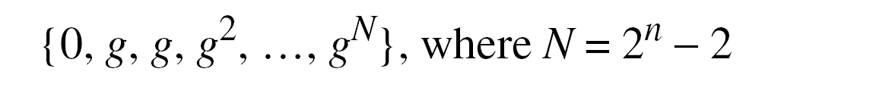
Using a Generator
Sometimes it is easier to define the elements of the GF(2^{n}) field using a
generator.

Slide 24
Example
Generate the elements of the field GF(2⁴) using the irreducible polynomial
ƒ(x) = x⁴ + x + 1.
Solution: The elements 0, g⁰, g¹, g2, and g³ can be easily generated,
because they are the 4-bit representations of 0, 1, x², and x³.
Elements g⁴ through g¹⁴, which represent x⁴ though x¹⁴ need to be
divided by the irreducible polynomial.
To avoid the polynomial division,
the relation ƒ(g) = g⁴ + g + 1 = 0 can be used.

Slide 25
Continued..

Slide 26
Example
The following show the results of addition and subtraction operations:
The following show the result of multiplication and division operations:

Slide 27
Summary
The finite field GF(2^{n}) can be used to define four operations of
addition, subtraction, multiplication and division over n-bit words.
The only restriction is that division by zero is not defined.

Slide 28
Thank You!
Next Class
Mandatory reading for the next class
https://iacr.org/archive/eurocrypt2001/20450451.pdf
10 June 2020

Slide 29


Vineetha B
Computer Science and Engineering
PES University, Bengaluru
10 June 2020

